Slide 1
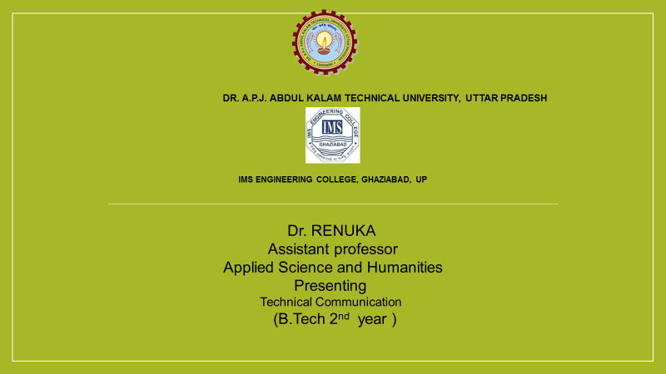

Slide 2
Unit -1 Fundamentals of Technical Communication
1) Define communication
2) Purpose of communication
3) Process of communication
4) Types of communication
5) Language as a tool of communication
6) Define Technical communication
7) Features of Technical communication
8) Distinguish between Technical and General communication
9) Dimensions of communication
10) Reading and Comprehension
11) Technical writing
12) Technical Style
13) The flow of communication
14) Barriers to communication
.

Slide 3
COMMUNICATION
The word ‘communication’ comes from the Latin word ‘communicare’, which means ‘to share’, i.e., to share information, ideas, and knowledge between a sender and a receiver.
Communication is the act of conveying meanings from one entity or group to another through the use of mutually understood signs, symbols, and semiotic rules.
Communication is simply the act of transferring information from one place, person or group to another.

Slide 4
PURPOSES /FUNCTIONS OF COMMUNICATION
While defining communication Keith Davis compared it to a bridge of meaning which helps a person to cross a river of misunderstanding.
In fact, this definition highlights the purpose of communication in one’s personal and professional life.

Slide 5
Classification of Purpose
GENERAL
To inform
To persuade
To entertain
SPECIFIC
Whom we want to influence
What we want them to think or do
When and where we want them to do it.

Slide 6
COMMUNICATION PROCESS
The communication is a dynamic process that begins with the conceptualizing of ideas by the sender who then transmits the message through a cannel to the receiver, who in turn gives the feedback in the form of some message or signal with the given time frame .

Slide 7
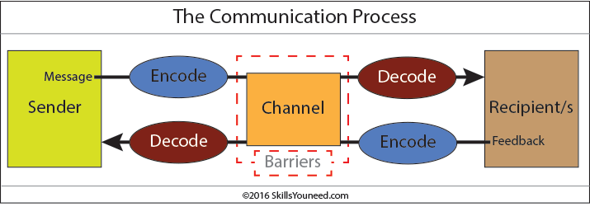

Slide 8
1. SENDER
The sender or the communicator is the person who initiates the conversation and has conceptualized the idea that he intends to convey it to others.
The sender has a message or purpose of communicating to one or more people.
A manager in an organization has to communicate information about the tasks to be achieved or a production deadline to be met by his subordinate employees. Without a reason, purpose, or desire, the sender has no information/message to s

Slide 9
2. Encoding
In the next stage, encoding takes place when the sender translates the information or message into some words, signs or symbols. Without encoding the information cannot be transferred from one person to another. In encoding the message, the sender has to choose those words, symbols or gestures that he believes to have the same meaning for the receiver. While doing so, the sender has to keep the level of the receiver in mind and accordingly communicate with him in the way the receiver understands it.
The message may be in any form that can be understood by the receiver. Speech is heard; words are read; gestures are seen or felt and symbols are interpreted. For example, there are several communications we make with a wave of the hand or with a nod of the head, a pat on the back, blinking of eyes.

Slide 10
3. Message
Once the encoding is finished, the sender gets the message that he intends to convey.
The message can be written, oral, symbolic or non- verbal such as body gestures, silence, sighs, sounds, etc. or any other signal that triggers the response of a receiver.

Slide 11
4. Channel
The channel is the medium used for transmission of information or message from sender to receiver. There are various media like telephone, mail through post, internet, radio, TV, press etc.
For communication to be effective and efficient, the channel must be appropriate for the message. A phone conversation is not a suitable channel for transmitting a complex engineering diagram.
An express mail may be more appropriate. The needs and requirements of the receiver must also be considered in selecting a channel. If the receiver is illiterate, sending the message through postal mail is not relevant.
Similarly, you cannot select the medium of telephone, if the receiver does not have a telephone with him. Therefore, in choosing the appropriate channel, the manager must decide whether feedback is important or not.
Oral, virtual, written, sound, gesture, etc. are some of the commonly used communication mediums.

Slide 12
5. Receiver
The receiver is the person who senses or perceives or receives the sender’s message. There may be just one receiver or a large number of receivers.
The message must be prepared with the receiver’s background in mind.
The degree to which the receiver decodes the message depends on his knowledge of the subject matter, experience, trust and relationship with the sender.
An engineer in a software organization should avoid using technical terms in communicating with his family members. It should be recognized that if the message does not reach a receiver, no communication takes place. Even, when the message reaches the receiver, if he cannot understand it, again there is no communication.

Slide 13
6. Decoding
Decoding is the process through which the receiver interprets the message and translates it into meaningful information.
It may be remembered that decoding is affected by the receiver’s past experience, personal assessments of the symbols and gestures, expectations, and mutuality of meaning with the sender.
An effective communication occurs only if the receiver understands the message in exactly the same way as it was intended by the sender.

Slide 14
7. Feedback
The feedback is the final step of the process that ensures the receiver has received the message and interpreted it correctly as it was intended by the sender.
It increases the effectiveness of the communication as it permits the sender to know the efficacy of his message.
The response of the receiver can be verbal or non- verbal

Slide 15
ACTIVITY
Define communication.
What are the functions of communication?
Communication is a two- way process. Explain in this context the elements of communication process.
Frame the Sentences of the given words:
Aberration
Agile
Ambivalence
d) Artifice
e) Audacious

